Slide 1

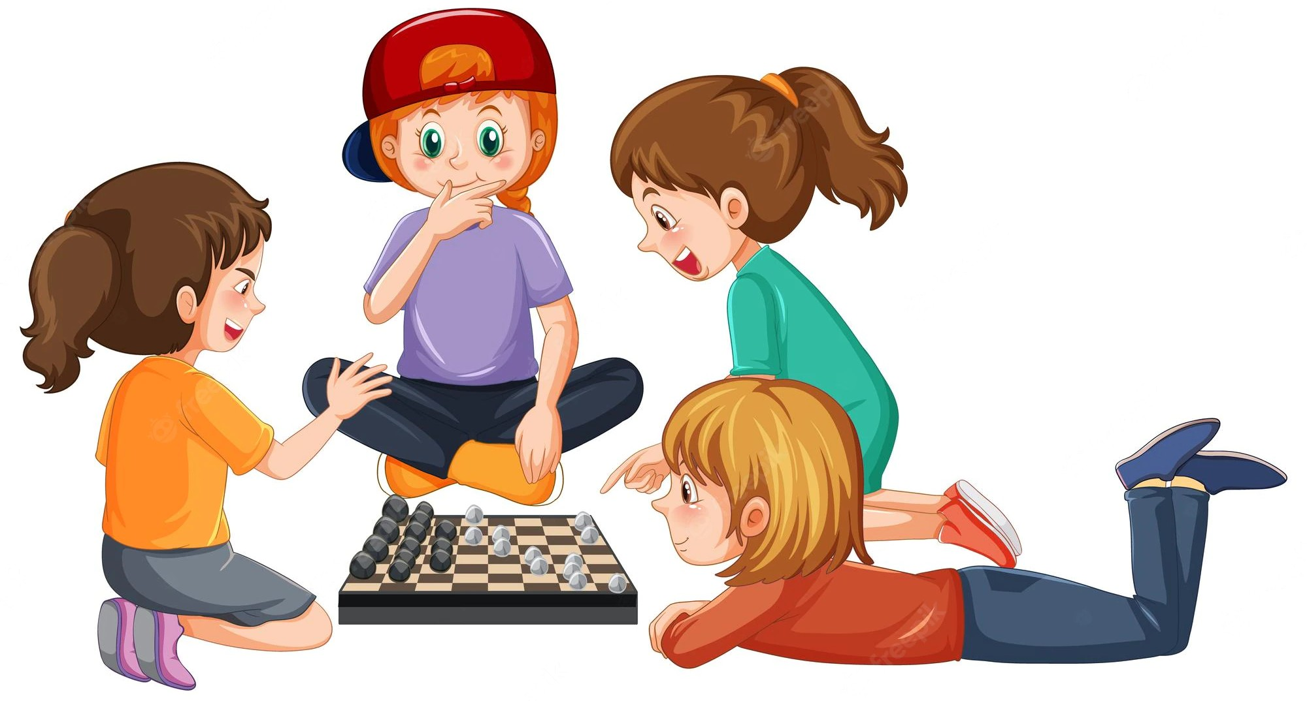

1
Let your child's intelligance growth
we have many categories of games that grow minds of your children
Get started
links
Home
serviece products
About us
login register logout
our products
contact us
Get in touch with our via phone .we are waiting for your call or message
Created by Students Faculity of Computing and Information Technology in Rabigh
©2022 kidGames
kidGames@gmail.com

Slide 2
1
Home
products createProduct
information about project explain project
login register
Let your child's intellig
we have many categories of games that grow mi
ance growth
nds of your children
Get started
links
Home
serviece products
About us
login register logout
our products
contact us
Get in touch with our via phone .we are waiting for your call or message
Created by Students Faculity of Computing and Information Technology in Rabigh
©2022 kidGames
kidGames@gmail.com

Slide 3

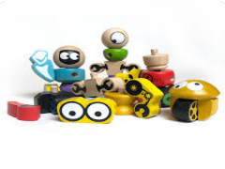
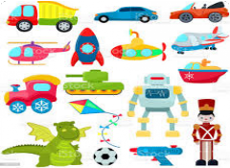
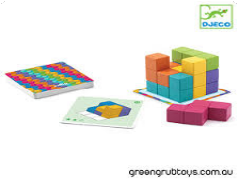
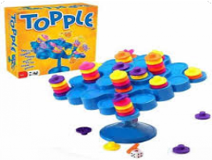


Categories
0
cartoon sport
Vehicle models Baby&Toddler Learning Toys Action games
Intelligence&puzzle Toys
search
Filter
toys games
cartoon game
puzzle game
simple puzzle
simple game
price
3 $
Add
price
7 $
Add
price
3 $
Add
price
4 $
Add
price
3 $
Price
Min Max
Add
Set Price
funny game
dance game
cartoon games
price
4 $
price
9 $
Add
price
12 $
Add
Add
links
Home
serviece products
About us
login register logout
our products
contact us
Get in touch with our via phone .we are waiting for your call or message
Created by Students Faculity of
Computing and Information Technology in Rabigh
©2022 kidGames
kidGames@gmail.com

Slide 4


1
Category : puzzle
this the best games for mind of your children
$ 3
Quantity: 7
+
1
-
total: 3$
ADD TO CARD
links
Home
serviece products
About us
login register logout
our products
contact us
Get in touch with our via phone .we are waiting for your call or message
Created by Students Faculity of
Computing and Information Technology in Rabigh
©2022 kidGames
kidGames@gmail.com

Slide 5

1
Notice: session_start(): Ignoring session_start() because a session is already active in C:\xampp\htdocs\kidsGame\views\header.php on line 2
Login
Email:
Enter email
password:
Enter password
forget password?
login
links
Home
serviece products
About us
login register logout
our products
contact us
Get in touch with our via phone .we are waiting for your call or message
Created by Students Faculity of
Computing and Information Technology in Rabigh
©2022 kidGames
kidGames@gmail.com

Slide 6

1
register
name:
Enter name
Email:
Enter email
password:
Enter password
confirm password: confirm password
register
has acount->
links
Home
serviece products
About us
login register logout
our products
contact us
Get in touch with our via phone .we are waiting for your call or message
Created by Students Faculity of
Computing and Information Technology in Rabigh
©2022 kidGames
kidGames@gmail.com

Slide 7
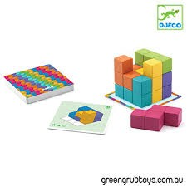
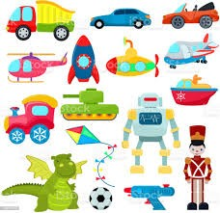
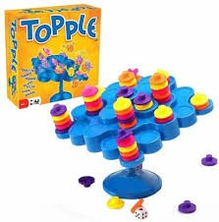
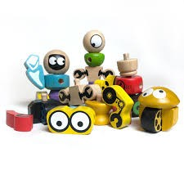
4
total : 38 $
puzzle game
+
2
-
6$
X
cartoon game
+
2
-
14$
X
simple game
+
3
-
9$
X
toys games
+
3
-
9$
X

